Slide 1
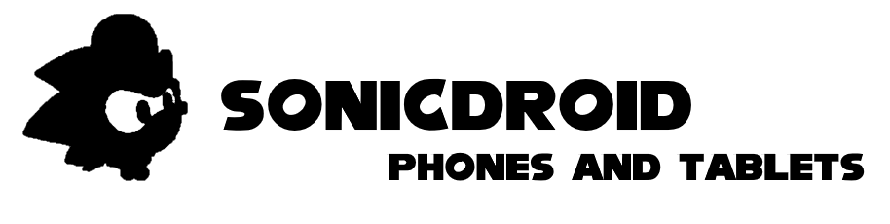
Powered by

Slide 2
Available on TrigStation, TrigStation 2, TrigOS, PC, Mac, SonicDroid, iSonic, Linux, and more! It’s..

Slide 4

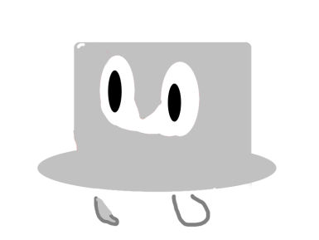
Sonic Pro
And Cappy
Press START to play!

Slide 6
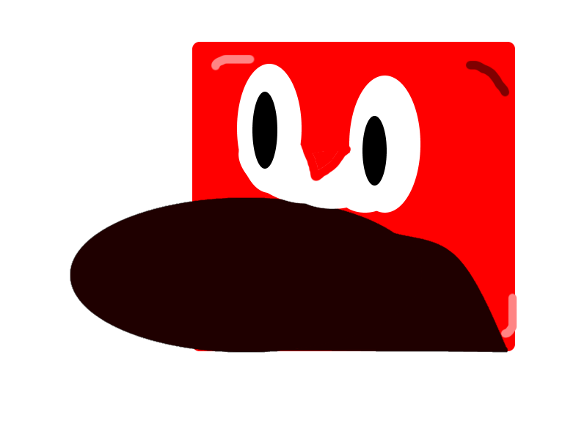
Loading…

Slide 7



Slide 8
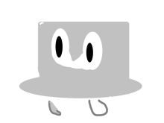

Slide 9


Slide 10

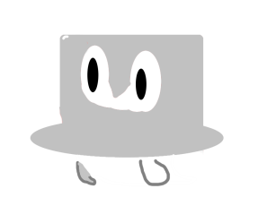
Mission Completed!

Slide 11
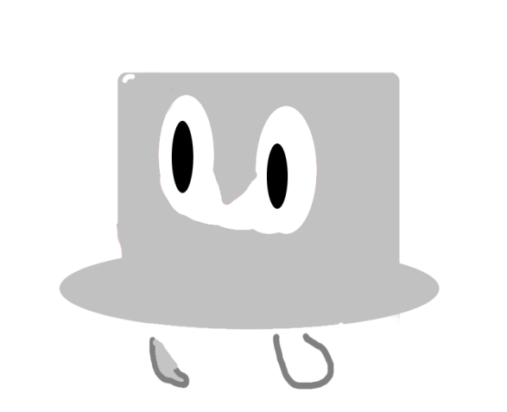

Thanks for playing!
Now, try again.
Try Again!

